Slide 1
Introduction to Computing
L3-L5

Slide 2
Review
Problem solving
Logic and its importance in problem solving
Computational problems and its classifications
Computer organization and operating system
Different computer languages
Typical C program development environment

Slide 3
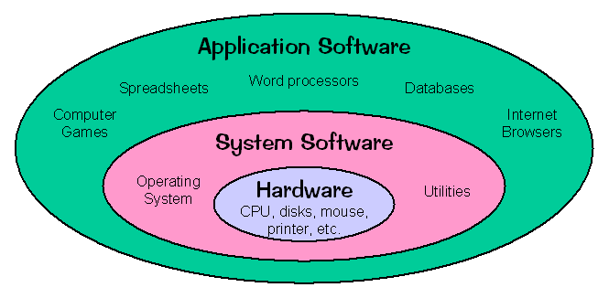
Application software, System software & Hardware
Notes:
Without CPU, you cant even think of a PC, and without OS, your PC is useless

Slide 4
Objectives for today
To learn and appreciate the following concepts
Introduction to algorithms and flowcharts
Algorithms and flowcharts for simple problems
Simple C programs

Slide 5
Session outcome
At the end of session the student will be able to write
Algorithms and flowcharts for simple problems
Simple C programs

Slide 6
Algorithm
A step by step procedure to solve a particular problem
Named after Arabic Mathematician Abu Jafar Mohammed Ibn Musa Al Khowarizmi

Slide 7
Algorithmic Notations
Name of the algorithm [mandatory]
[gives a meaningful name to the algorithm based on the problem]
Start [Beginning of the algorithm]
Step Number [mandatory]
[indicate each individual simple task]
Explanatory comment [optional]
[gives an explanation for each step, if needed]
Termination [mandatory]
[tells the end of algorithm]
Notes:
Additional notes on problem solving skills
Problem solving Skill is the key skill required for a software engineer as it helps to develop technical as well as soft skills.
Logical Thinking
Thinking in terms of cause and consequences
Sequential thinking
Means following a train of thought
Helps in decision making and problem solving

Slide 8
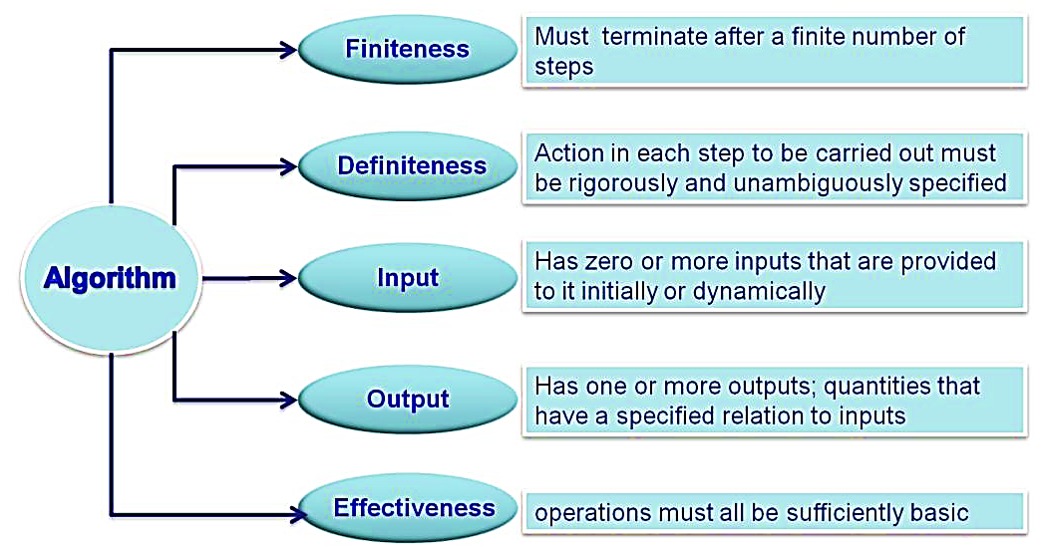
Properties of an algorithm

Slide 9
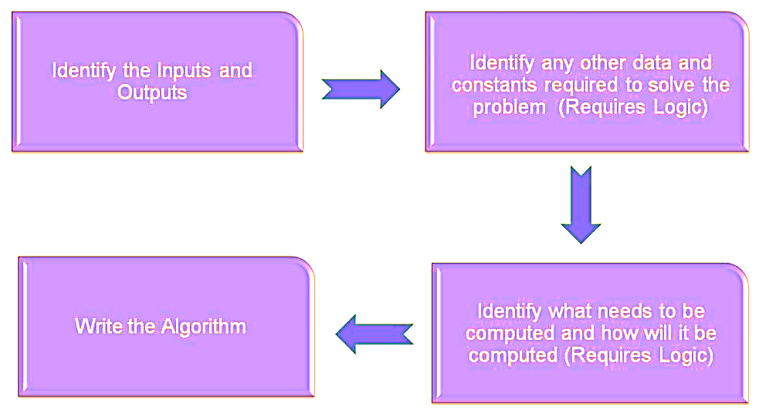
Steps to develop an algorithm

Slide 10
Compute the area of circle
Name of the algorithm : Compute the area of a circle
Step1: Start
Step 2: Input radius
Step 3: [Compute the area]
Area ← 3.1416 * radius * radius
Step 4: [Print the Area]
Print ‘Area of a circle =‘, Area
Step 5: [End of algorithm]
Stop

Slide 11
Interchange values of two variables
Name of the algorithm: Interchange values of 2 variables
Step 1: Start
Step 2: Input A,B
Step 3: temp ← A
Step 4: A←B
Step 5: B←temp
Step 6: Print ‘A=’ , A
Print ‘B=’ , B
Step 7: [End of Algorithm]
Stop

Slide 12
Largest of 3 numbers
Name of the algorithm: Find largest of 3 numbers
Step 1: Start
Step 2: [Read the values of A, B and C]
Read A, B, C
Step 3: [Compare A and B]
if A>B Go to step 5
Step 4: [Otherwise compare B with C]
if B>C then
Print ‘B’ is largest’
else
Print ‘C’ is largest’
Go to Step 6
Step 5: [Compare A and C for largest]
if A>C then
Print ‘A’ is largest’
else
Print ‘C’ is largest’
Step 6: [End of the algorithm]
Stop

Slide 13
Largest of 3 Numbers contd
Step 5: [Compare A and C for largest]
if A>C then
Print ‘A’ is largest’
else
Print ‘C’ is largest’
Step 6: [End of the algorithm]
Stop

Slide 14
Factorial of a number
Name of the algorithm: Compute the factorial of a number
Step1: Start
Step 2: Input N
Step 3: fact ←1
Step 4: for count=1 to N in step of 1 do
begin
fact←fact*count
end
Step 5: Print ‘fact of N=‘, fact
Step 6: [End of algorithm]
Stop

Slide 15
Tutorial on Algorithms
Write the algorithm to
Find the area of triangle when three sides are given.
Add two integers
Find the sum of digits of a number
Find the Sum and Mean of first N natural numbers

Slide 16
Flowcharts
In Computer Science, Flow chart is used to represent algorithm which basically provides a solution to any computational problem.
Flowchart: A graphical/pictorial representation of computation

Slide 17
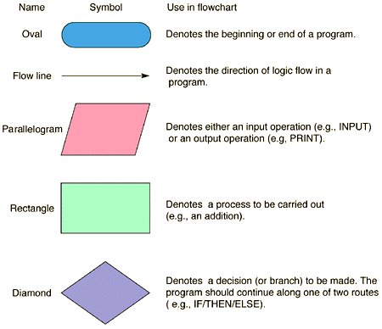
Basic Flowchart Symbols

Slide 18
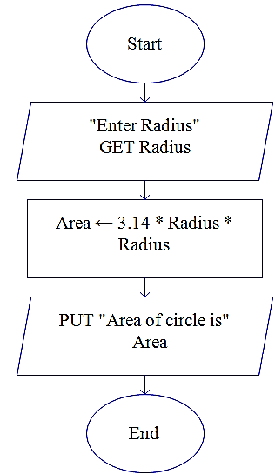
Area of the circle
Name of the algorithm:
Compute the area of a circle Flowchart
Step1: Input radius
Step 2: [Compute the area]
Area ← 3.1416 * radius*radius
Step 3: [Print the Area]
Print ‘Area of a circle =‘, Area
Step 4: [End of algorithm]
Stop

Slide 19
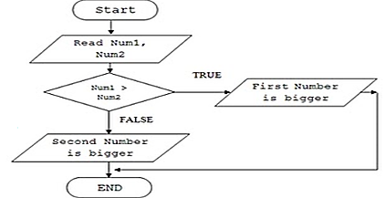
Comparing two numbers
Flowchart
Name of the algorithm: Comparing 2 numbers
Step 1: Start
Step 2: Input num1, num2
Step 3: if num1 > num2 then
Print num1 is bigger
else
Print num2 is bigger
Step 4: end

Slide 20
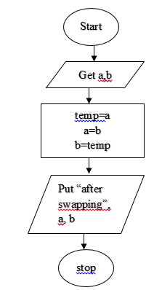
Swapping two numbers
Name of the algorithm: Swapping 2 numbers Flowchart
Step1: Input two numbers
Step 2: [swapping]
temp=a
a=b
b=temp
Step 3: [Print]
Print ‘after swapping=‘, a, b
Step 4: [End of algorithm]
Stop

Slide 21
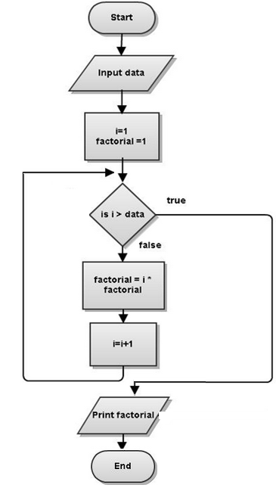
Find Factorial of given no
Name of the algorithm: Compute the factorial of a number
Step1: Start
Step 2: Input data
Step 3: factorial ←1
Step 4: for i=1 to N in step of 1 do
begin
factorial←factorial*i
end
Step 5: Print ‘fact of N=‘, factorial
Step 6: [End of algorithm]
Stop

Slide 22
Key features of flow chart
Diagrammatic / visual / graphical representation of computation of an algorithm/pseudo code
Easier to understand and analyze the problem and it’s solution before programming
Machine independent
Well suited for any type of logic

Slide 23
Tutorial
Write the flowchart to find the area of triangle when three sides are given
Write the flowchart to add two integers

Slide 24
Summary
What is Algorithm and Flowchart
Writing algorithms and drawing flowcharts for simple problems

Slide 25
Problem Solving Using Computers
Steps in Problem Solving
Problem solving is a part of our day to day activity.
Algorithm
Flowchart
Code
Documenting
Notes:
What is Problem Solving?
Every problem in the real world needs to be identified and solved. Trying to find a solution to a problem is known as problem solving.
Problem solving becomes a part of our day to day activity. Especially, when we use computers for performing our day to day activity.
How to solve a problem?
If you have a problem, either you can solve it manually or using computer.
2. If the problem is easy enough, solve it manually or else use computers.
3. Bigger problems can be sub-divided into smaller problems (sub-problems) and start solving them one by one.
4. After completing solving sub-problems, the entire big problem has been solved easily.

Slide 26
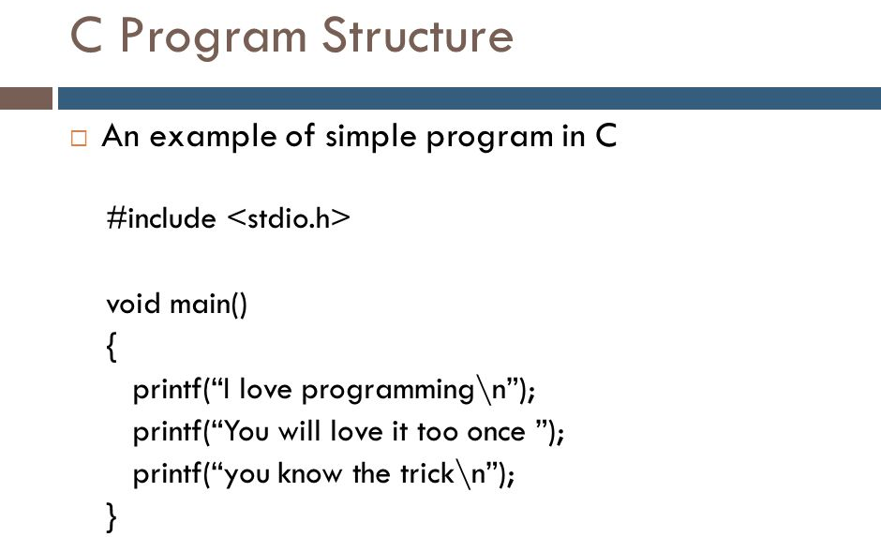

Slide 27
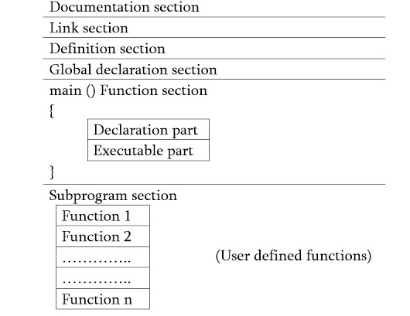
General Structure of C program

Slide 28
General Structure of C program
Documentation section:
The documentation section consists of a set of comment lines giving the name of the program, the author and other details, which the programmer would like to use later.
Link section: The link section provides instructions to the compiler to link functions from the system library such as using the #include directive.
Definition section: The definition section defines all symbolic constants such using the #define directive.
Global declaration section: There are some variables that are used in more than one function. Such variables are called global variables and are declared in the global declaration section that is outside of all the functions. This section also declares all the user-defined functions.

Slide 29
General Structure of C program
main () function section: Every C program must have one main function section. This section contains two parts; declaration part and executable part
Declaration part: The declaration part declares all the variables used in the executable part.
Executable part: There is at least one statement in the executable part. These two parts must appear between the opening and closing braces. The program execution begins at the opening brace and ends at the closing brace. The closing brace of the main function is the logical end of the program. All statements in the declaration and executable part end with a semicolon.
Subprogram section: If the program is a multi-function program then the subprogram section contains all the user-defined functions that are called in the main () function. User-defined functions are generally placed immediately after the main () function, although they may appear in any order.
All sections, except the main () function section may be absent when they are not required.

Slide 30
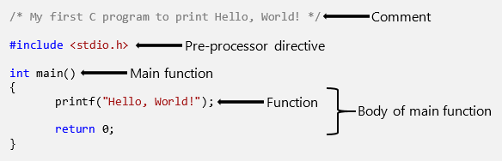
Hello world program

Slide 31
Formatting in C
Statements are terminated with semicolons.
Indentation to be used for increased readability.
Free format: white spaces and indentation is ignored by compiler.
New line is represented by \n (Escape sequence).

Slide 32
Formatting in C
C is case sensitive – pay attention to lower and upper case letters when typing !
All keywords and standard functions are lower case
Typing MAIN, Main etc instead of main is a compiler error
Strings are placed in double quotes

Slide 33
C program for reading a number and display it on the screen
#include<stdio.h>
int main()
{
int num;
printf("\nEnter the number: ");
scanf("%d", &num);
printf(“The number read is: %d", num);
return(0);
}

Slide 34
scanf()
scanf ( ) is used to obtain the value from the user through an input device (keyboard).
Eg: scanf(“%d”, &number);
int main(){
int num;
printf("\nEnter the number: ");
scanf("%d", &num);
printf(“The number read is: %d", num);
return(0);
}
Notes:
Scanf is used to obtain the value from the user
The scanf function reads from the standard input, which is usually the keyboard.
Eg: Scanf(“%d”, &integer1);
This scanf has two arguments, "%d" and &integer1.
The first argument, the format control string, indicates the type of data that should be input by the user. The %d conversion specifier indicates that the data should be an integer
The second argument of scanf begins with an ampersand (&)—called the address operator in C— followed by the variable name. The ampersand, when combined with the variable name, tells scanf the location (or address) in memory at which the variable integer1 is stored.
When the computer executes the preceding scanf, it waits for the user to enter a value for variable

Slide 35
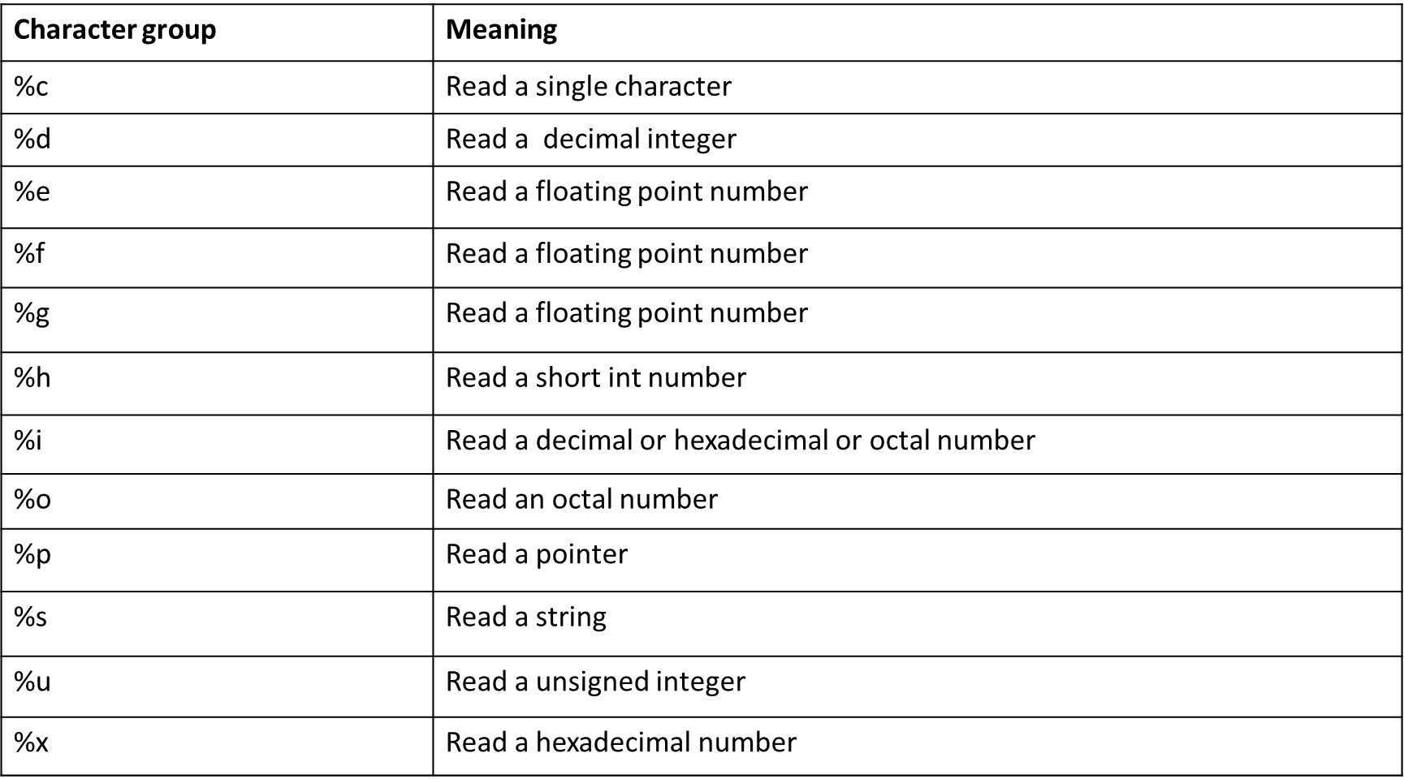
C program essentials: Format specifiers
Similarly, the format specifiers are used with printf( ) function for printing/displaying.

Slide 36
Input/ Output functions
C provides the printf( ) to display the data on the output device (monitor).
It is included in stdio.h
Examples are:
printf(“programming is an art”);
printf(“%d”, number);
printf(“%f%f”, p, q);
int main() {
int num;
printf("\nEnter the number: ");
scanf("%d", &num);
printf(“The number read is: %d", num);
return(0);
}
Notes:
To print is to produce output for the user to read, whereas to scan is to read input from the command line that the user types in.
The f at the end stands for "formatted".
So both printf and scanf functions use codes within a format string to specify how output or input values should be formatted

Slide 37
Adding two integers
#include <stdio.h>
int main( void )
{/* start of function main */
int sum; /* variable in which sum will be stored */
int integer1; /* first number to be input by user */
int integer2; /* second number to be input by user */
printf( "Enter first integer\n" );
scanf( "%d", &integer1 ); /* read an integer */
printf( "Enter second integer\n" );
scanf( "%d", &integer2 ); /* read an integer */
sum = integer1 + integer2; /* assign total to sum */
printf( "Sum is %d\n", sum ); /* print sum */
return 0; /* indicate that program ended successfully */
} /* end of function main */

Slide 38
Syntax and Logical errors
Syntax errors: violation of programming language rules (grammar).
Detected by the compiler
Eg: printf (“hello world”) // semicolon missing
Logical errors: errors in meaning:
Programs are syntactically correct but don’t produce the expected output
User observes output of running program

Slide 39
Summary
Problem solving !
Program structure
Formatting
Input / Output
Simple C programs

